Slide 1
CSE 306
Group 27
Abedur Rahman Khan 201914011
Tasnim Fariha 201914034
Tasnim Tabassum Rima 201814105

Slide 2
Social Distancing Indicator and Alarming System

Slide 3
Sensors and Components
Arduino Uno
Ultrasonic Distance Sensor
NeoPixel Ring 12 RGB LEDs
Piezo Buzzer
BreadBoard
Wires

Slide 4
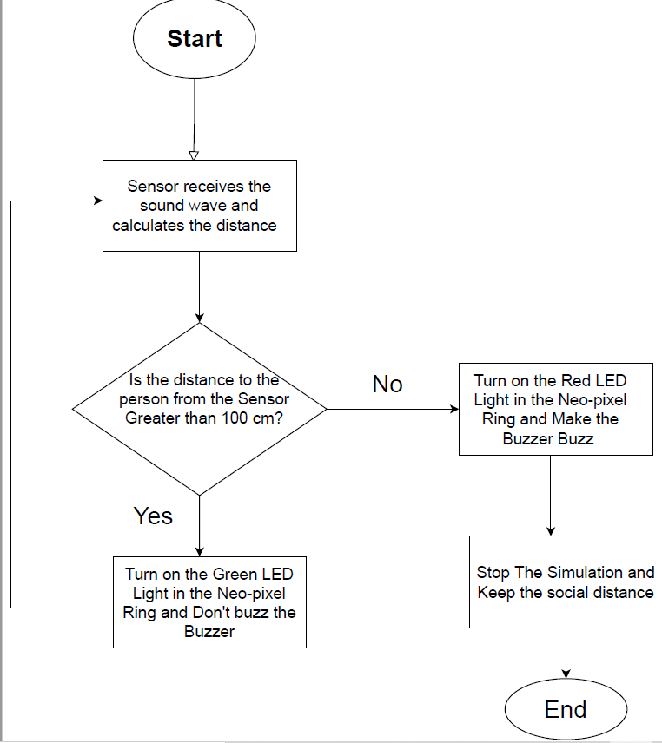
Flow Chart

Slide 5
Work Procedure
We used Ultra-sonic distance sensor where Trigger pin is used to trigger the ultrasonic sound pulses. This pin has to be kept high for 10 micro seconds to initialize measurement by sending US waves and then it will be kept low.
Echo pin goes high for a period of time which will be equal to the time taken for the US wave to return back to the sensor. It will be low when the reflected signal is produced. With the help of this time duration, we can get twice the distance from the sensor to the object , that we can divide by 2 and get the actual distance.

Slide 6
Work Procedure
If we get distance higher than or equal to max distance , we set the distance to max distance. Then if we get distance lower than or equal to min distance , we set the distance to min distance.
If the distance is min distance, buzz the buzzer and turn on the Red light.
Otherwise , we don’t buzz it and turn on the Green light.
Moreover, we keep the yellow lights on when any person comes closer to the sensor and it’s a caution for the person so that he can keep distance from the other person.

Slide 7
Features
The application measures distance and lights up all red lights and buzz the piezo buzzer to secure physical distance if the distance between two persons is below 100 cm, while encouraging and sustaining virtual social connection.
We keep the yellow lights on below 200 cm to send a precaution message so that the person can be aware of the social distance.
We keep the green lights on if two persons are over 200 cm or at 300 cm which is the maximum distance or above 300 cm.
For yellow and green lights, we don’t buzz the piezo buzzer

Slide 8
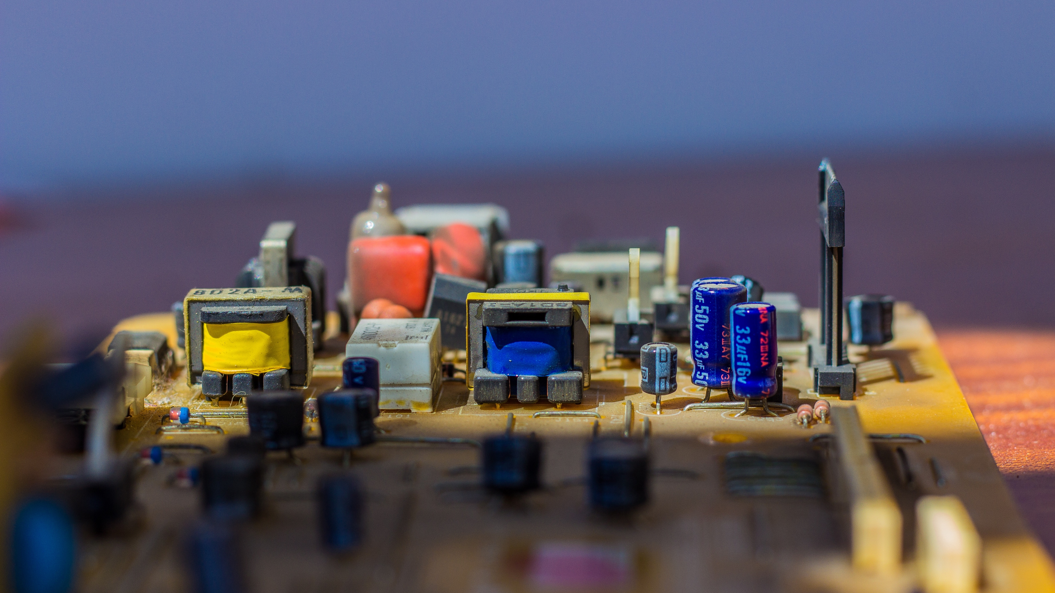
THANK YOU !!!
Any Queries?

